Slide 1
Team Midtown's solution

Slide 5
Technical Architecture

Slide 6
Cost – Benefit Analysis
Notes:
Doesn’t have an automated system can save both money and time by implementing a system that automates and stores transactions/appointments

Slide 7
Timeline
Year 1
Insert small text
Year 2
Insert small text
Year 3
Insert small text

Slide 8
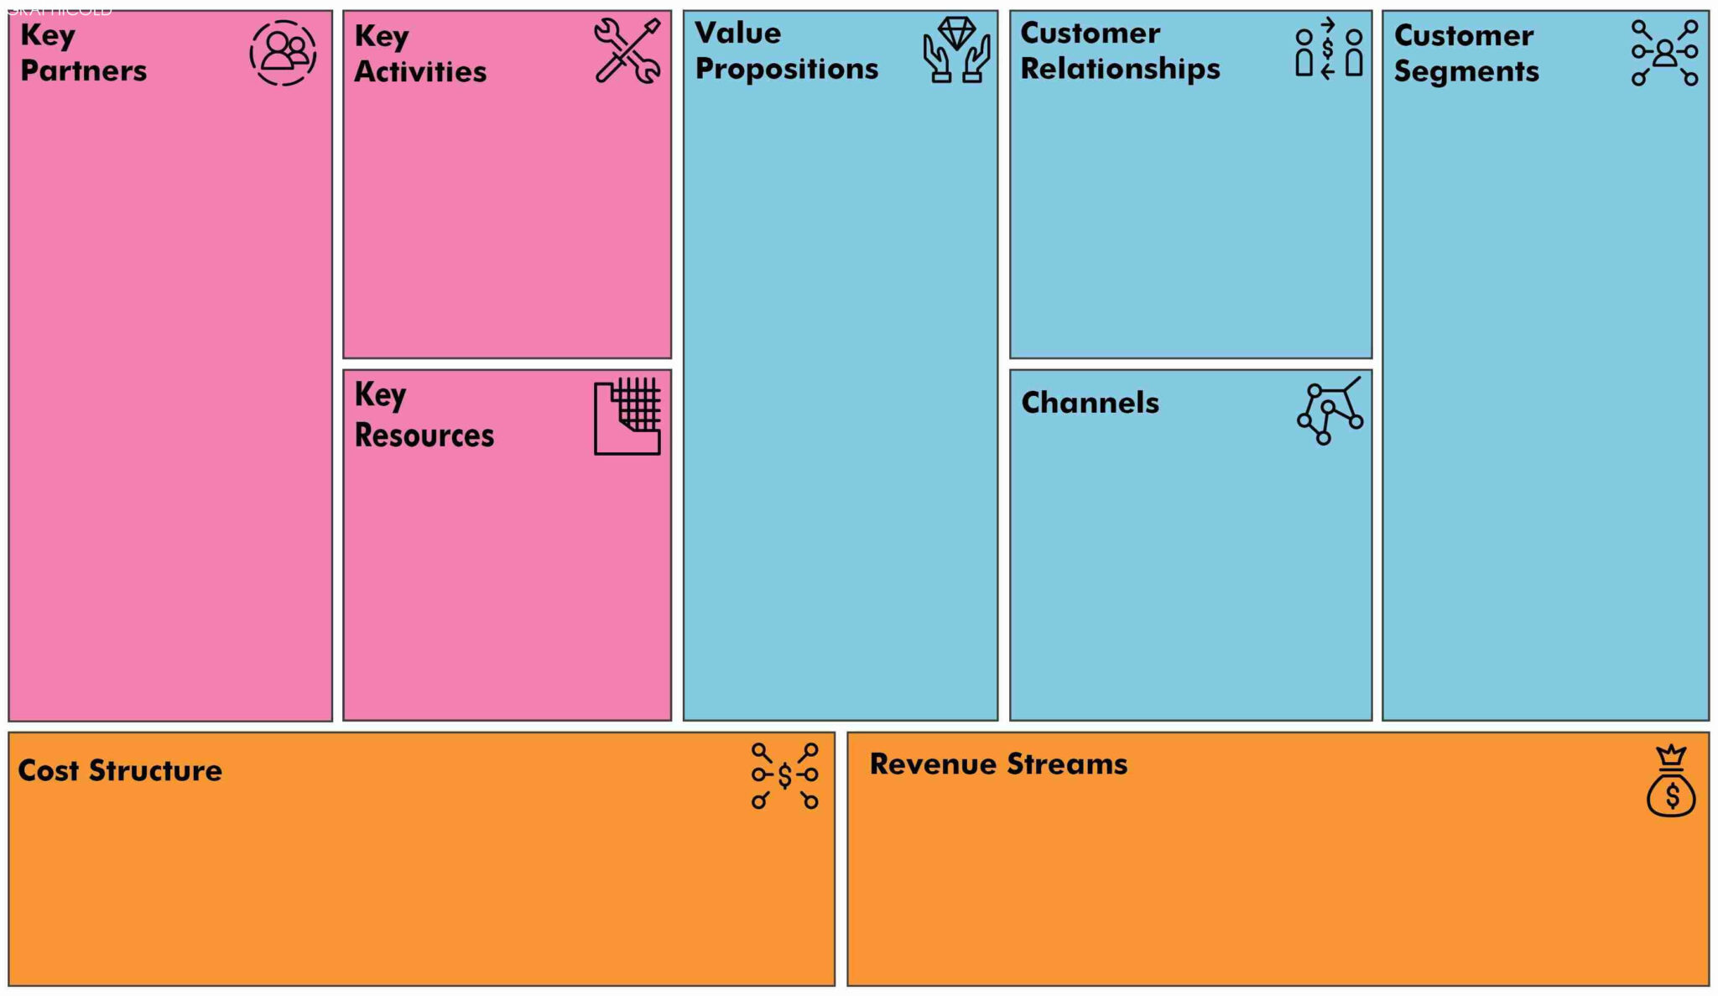
Lean CANVAS BUSINESS MODEL
Sign in
Sign up
Online payment
Schedule drop off
Pick up
Scheduling services
Online payments
User-Friendly Interface
Special Events
Visiting Hours
New Partnered Companies (scale)
Modern Working Age Families
Off Campus
Google search
Word of mouth
Mobile phone
Website
Employees
Elderly Care Starting Cost ($99,000-$627,000)
Pet Care Starting Cost ($2,000-$10,000)
Background Check Overall Cost ($20-$100)
Payments made online
Affordable
Notes:
MOST LIKELY NOT USING THIS SLIDE

